Slide 2
Snowflake Stream
Stream - Into
What is Stream ?
A stream object records data manipulation language (DML) changes made to tables, including inserts, updates, and deletes, as well as metadata about each change, so that actions can be taken using the changed data. This process is referred to as change data capture (CDC).
An individual table stream tracks the changes made to rows in a source table. A table stream (also referred to as simply a “stream”) makes a “change table” available of what changed, at the row level, between two transactional points of time in a table. This allows querying and consuming a sequence of change records in a transactional fashion.
When created, a table stream logically takes an initial snapshot of every row in the source table by initializing a point in time (offset) as the current transactional version of the table

Slide 3
Snowflake Stream
Stream - Into
An insert operation generates a single row in the stream. Based on the METADATA$ACTION and METADATA$ISUPDATE column values, you can see a record was inserted and no update took place.
An update operation generates two rows in the stream: the METADATA$ACTION column shows two entries (INSERT and DELETE), and the two entries in the METADATA$ISUPDATE column are both TRUE. Notice the entry in the METADATA$ROW_ID column is the same for both rows.
You need to concern yourself with only one of those records, so let’s use the one where the METADATA$ACTION entry is INSERT and the METADATA$ISUPDATE entry is TRUE.
A delete operation generates a single row in the stream. The entry in the METADATA$ACTION column is DELETE, similar to what you saw with the INSERT statement above, but the entry in the METADATA$ISUPDATE column is FALSE. So you know the record was deleted, not updated.

Slide 4
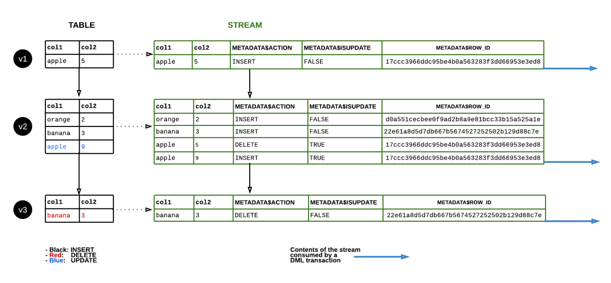
Snowflake Stream
Stream - Into

Slide 5
Snowflake Stream
Stream - Into
John
John
Roy
Roy
Stream Object
Offset 2 (Time) 9:50
Offset 1 (Time) 9:30

Slide 6
Snowflake Stream
Types of streams
Types of Streams
1) Standard Streams – Insert, update, delete
2) Append only streams -- Insert

